Slide 1


Advertising & Communication Management
Lecture 4
Creative Strategy – Planning & Development. Message appeals, positioning, and campaign objectives
Polyxeni (Jenny) Palla, PhD

Slide 2
What is creativity?
Creativity is probably one of the most commonly used terms in advertising. Ads are often called creative.
What is meant by creativity in advertising?
In direct contrast to the client orientation, the art director, copywriter, and commercial director viewed the advertisement as a communication vehicle for promoting their own aesthetic viewpoints and personal career objectives.
Both the copywriter and art director made this point explicitly, noting that a desirable commercial from their standpoint was one which communicated their unique creative talents and thereby permitted them to obtain “better” jobs at an increased salary.
Hirschman

Slide 3

Advertising creativity
Advertising creativity is the ability to generate fresh, unique, and appropriate ideas that can be used as solutions to communications problems.
To be appropriate and effective, a creative idea must be relevant to the target audience.
Many ad agencies recognize the importance of developing advertising that is creative and different yet communicates relevant information to the target audience.

Slide 4
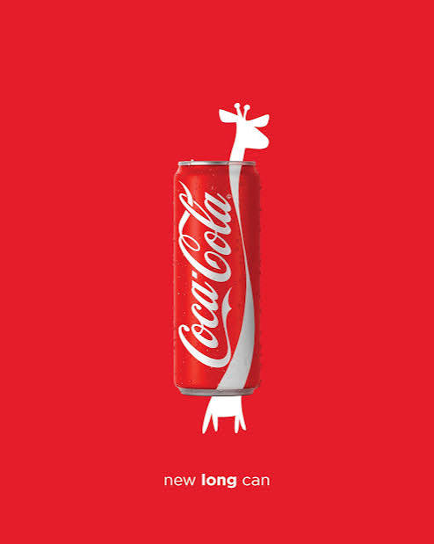
Advertising Creativity
Advertising creativity is not the exclusive domain of those who work on the creative side of advertising. The nature of the business requires creative thinking from everyone involved in the promotional planning process.
Agency people, such as account executives, media planners, researchers, and attorneys, as well as those on the client side, such as marketing and brand managers, must all seek creative solutions to problems encountered in planning, developing, and executing an advertising campaign.

Slide 5

Planning Creative Strategy
The job of the creative team is challenging because every marketing situation is different and each campaign or advertisement may require a different creative approach. Numerous guidelines have been developed for creating effective advertising,
but there is no magic formula.
As copywriter Hank Sneiden notes in his book Advertising Pure and Simple

Slide 6
Planning Creative Strategy
The Art of Participation in Advertising
Those who work on the creative side of advertising often face a real challenge. They must take all the research, creative briefs, strategy statements, communications objectives, and other input and transform them into an advertising message.
Their job is to write copy, design layouts and illustrations, or produce commercials that effectively communicate the central theme on which the campaign is based.
Rather than simply stating the features or benefits of a product or service, they must put the advertising message into a form that will engage the audience’s interest and make the ads memorable.

Slide 7
The Creative Challenge
Rules lead to dull stereotyped advertising, and they stifle creativity, inspiration, initiative, and progress. The only hard and fast rule that I know that
in advertising is that there are no rules.
No formulas. No right way. Given the same problem, a dozen creative talents would solve it a dozen different ways.
If there were a sure-fire formula for successful advertising, everyone would use it. Then there’d be no need for creative people.
We would simply program robots to create our ads and commercials and they’d sell loads of product—to other robots.

Slide 8

Creative Personnel
The educational background of creative personnel is often in nonbusiness areas such as art, literature, music, humanities, or journalism, so their interests and perspectives tend to differ from those of managers with a business education or background.
Creative people tend to be more abstract and less structured, organized, or conventional in their approach to a problem, relying on intuition more often than logic.
Yet the differences between creative and managerial personalities and perspectives must be recognized and tolerated so that creative people can do their best work and all those involved in the advertising process can cooperate

Slide 9
The Creative Process Young’s model
Young’s model of the creative process contains five steps:
Immersion. Gathering raw material and information through background research and immersing yourself in the problem.
Digestion. Taking the information, working it over, and wrestling with it in the mind.
Incubation. Putting the problems out of your conscious mind and turning the information over to the subconscious to do the work.
Illumination. The birth of an idea—the “Eureka! I have it!” phenomenon.
Reality or verification. Studying the idea to see if it still looks good or solves the problem; then shaping the idea to practical usefulness.

Slide 10
The Creative Process Graham Wallas
Young’s process of creativity is similar to a four-step approach outlined much earlier by English sociologist Graham Wallas:
Preparation. Gathering background information needed to solve the problem through research and study.
Incubation. Getting away and letting ideas develop.
Illumination. Seeing the light or solution.
Verification. Refining and polishing the idea and seeing if it is an appropriate solution.

Slide 11
The Creative Process
Young & Graham Wallas
Immersion.
Digestion.
Incubation.
Illumination.
Reality or verification.
Preparation.
Incubation.
Illumination.
Verification

Slide 12
Account Planning – the process
To facilitate the creative process, many agencies now use account planning, which is
a process that involves conducting research and gathering all relevant information about a client’s product or service, brand, and consumers in the target audience.

Slide 13
Advertising Campaigns- IMC
Most ads are part of a series of messages that make up an IMC or advertising campaign, which is
a set of interrelated and coordinated marketing communication activities that center on a single theme or idea that appears in different media across a specified time period.

Slide 14
Advertising Campaigns
A campaign theme should be a strong idea, as it is the central message that will be communicated in all the advertising and other promotional activities.
Advertising campaign plans are short-term in nature and, like marketing and IMC plans, are done on an annual basis
However, the campaign themes are usually developed with the intention of being used for a longer time period

Slide 15
Top 10 advertising slogans of the century
Company or Brand Campaign Theme
1. DeBeers Diamonds are forever
2. Nike Just do it
3. Coca-Cola The pause that refreshes
4. Miller Lite Tastes great, less filling
5. Avis We try harder
6. Maxwell House Good to the last drop
7. Wheaties Breakfast of champions
8. Clairol Does she . . . or doesn’t she
9. Morton Salt When it rains it pours
10. Wendy’s Where’s the beef?
https://advertisingnews.com/popular-slogans/

Slide 16


Slide 17


Slide 18


Slide 19
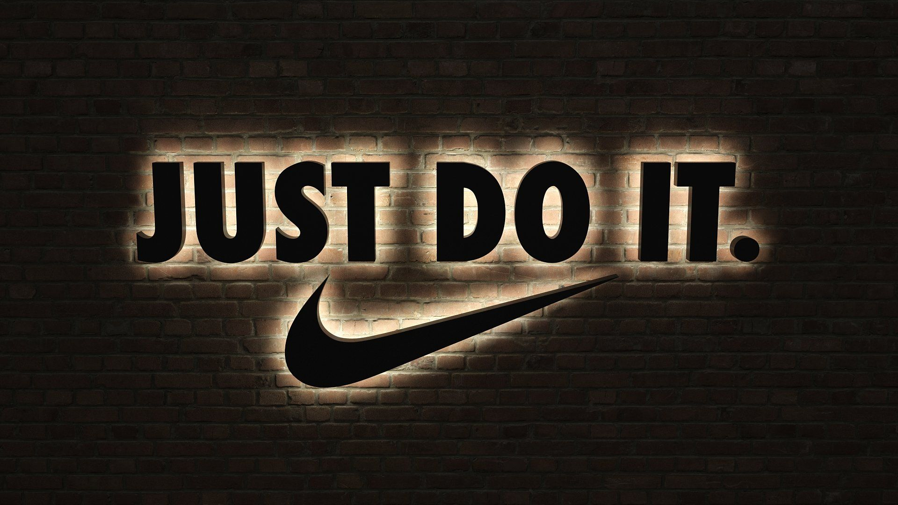

Slide 20
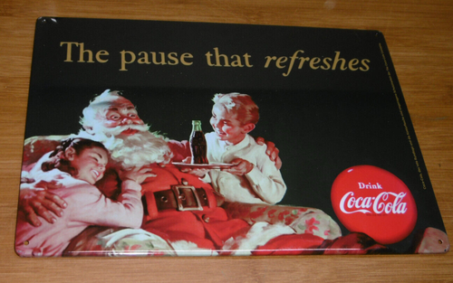

Slide 21
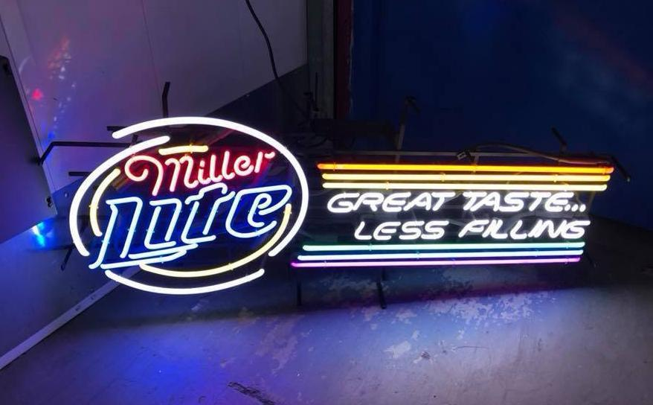

Slide 22


Slide 23


Slide 24
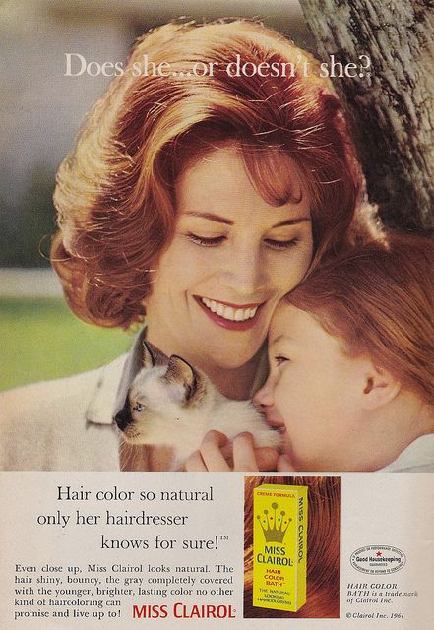

Slide 25
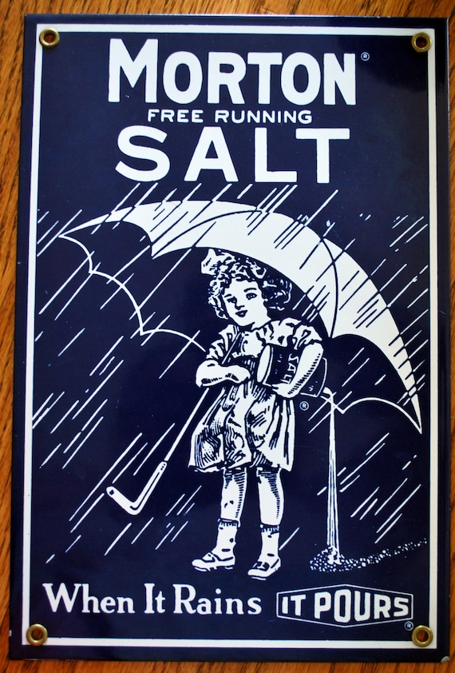

Slide 26


Slide 27
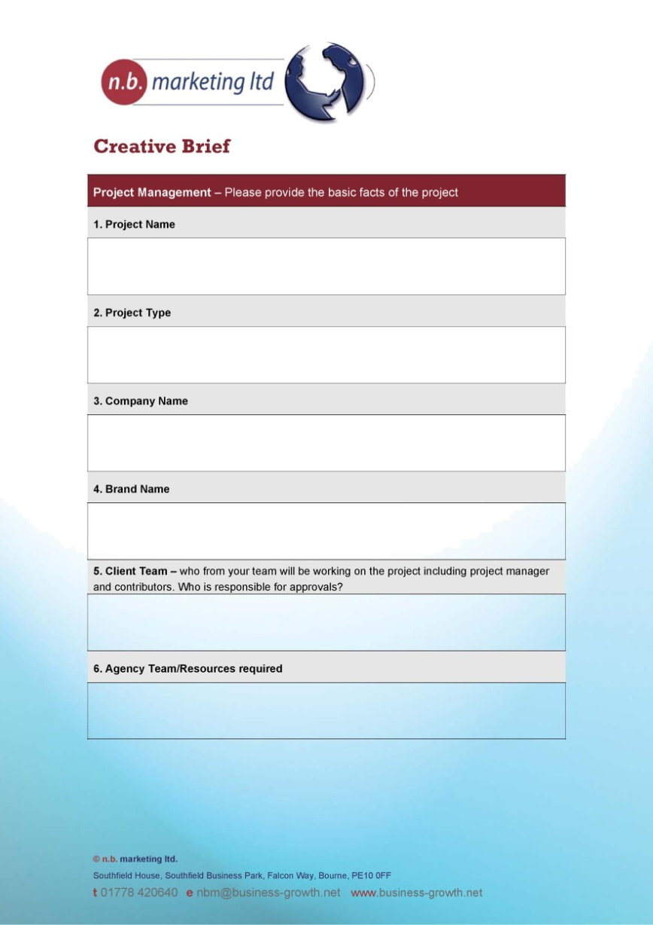
Copy Platform – Creative Brief
The written copy platform specifies the basic elements of the creative strategy. Different agencies may call this document a creative platform or work plan, creative brief, creative blueprint, or creative contract.

Slide 28
Copy Platform – Creative Brief
1. Basic problem or issue the advertising must address.
2. Advertising and communications objectives.
3. Target audience.
4. Major selling idea or key benefits to communicate.
5. Creative strategy statement (campaign theme, appeal, and execution technique to be used).
6. Supporting information and requirements.

Slide 29
the Major Selling Idea
The Search for the Major Selling Idea
An important part of creative strategy is determining the central theme that will become the
major selling idea of the ad campaign.
As A. Jerome Jeweler states in his book Creative Strategy in Advertising:
The major selling idea should emerge as the strongest singular thing you can say about your product or service. This should be the claim with the broadest and most meaningful appeal to your target audience.
Once you determine this message, be certain you can live with it; be sure it stands strong enough to remain the central issue in every ad and commercial in the campaign

Slide 30
inspiration for a big idea
Using a unique selling proposition.
Creating a brand image.
Finding the inherent drama.
Positioning.

Slide 31
Unique Selling Proposition
1. Each advertisement must make a proposition to the consumer. Not just words, not just product puffery, not just show-window advertising. Each advertisement must say to each reader: “Buy this product and you will get this benefit.”
2. The proposition must be one that the competition either cannot or does not offer. It must be unique either in the brand or in the claim.
3. The proposition must be strong enough to move the mass millions, that is, pull over new customers to your brand.30

Slide 32

Creating a Brand Image
Image advertising has become increasingly popular and is used as the main selling idea for a variety of products and services, including soft drinks, liquor, cigarettes, cars, airlines, financial services, perfume/ colognes, and clothing.
Many consumers wear designer jeans or Ralph Lauren polo shirts or drink certain brands of beer or soft drinks because of the image of these brands. The key to successful image advertising is developing an image that will appeal to product users

Slide 33
Discussion Questions
What are the various stages of the creative process? Do you agree with the notion that advertising creativity can or should follow a definitive process?
Find an example of an ad or campaign that you think reflects one of the approaches used to develop a major selling idea such as unique selling proposition, brand image, inherent drama, or positioning. Discuss how the major selling idea is reflected in this ad or campaign.

