Slide 1


Advertising & Communication Management
Digital Advertising Today
Polyxeni (Jenny) Palla, PhD

Slide 2
Table of Contents
Computational advertising
Computational advertising – AI
Automated Brand-Generated Content (ABC) Model

Slide 3
Computational Advertising
Computational advertising
Is central to the digital media landscape
Transforming how advertising messages are created and delivered, and evaluated.
It represents the shift form traditional mass advertising to data-driven, algorithmic persuasion (Zarouali et al., 2022)

Slide 4
Computational Advertising
As defined by Huh and Malthouse (2020, p. 1), computational advertising is
“a broad, data-driven advertising approach relying on or facilitated by enhanced computing capabilities, mathematical models/algorithms, and the technology infrastructure to create and deliver messages and monitor/surveil an individual’s behaviors.”
Building on this, Pearson (2024) extends its scope to include anticipating societal trends and adapting media planning to evolving economic, social, and environmental dynamics.

Slide 5

Computational Advertising
Today, diverse data, such as:
advertising expenditure,
media activity, and
detailed consumer behaviour,
are systematically collected and analysed to optimize the match between advertising messages and their target audiences.
https://www.computer.org/csdl/magazine/ex/2017/03/mex2017030003/13rRUwhpBH1

Slide 6

Computational Advertising: content-based filtering
Advertisers can apply various methods to process consumer data and personalize ads.
1st method: content-based filtering,
content-based filtering relies on
explicit data (i.e., explicit or overtly collected data that consumers are aware of being collected), searches or clicks,
to deliver personalized recommendations
Example: searching for flights to Athens results in ads promoting discounted airfare for flights to Athens.

Slide 7


Computational Advertising: collaborative filtering
2nd method: collaborative filtering,
It utilizes data from similar consumers to make recommendations.
Example:
if consumers with certain characteristics booked flights to a specific destination, this destination might get recommended to others with similar interests.
Beyond these, advertisers may employ probabilistic data usage, where multiple data points, often across platforms, are combined to infer consumer interests (i.e., implicit or covertly collected data).
Example, for consumers who have researched flights to Athens on an airline’s website and searched for popular tourist spots in Athens on social media platforms,
it can be inferred that they might be interested in hotels in Athens and thus shown messages/ads promoting a discount on stays in Athens.

Slide 8

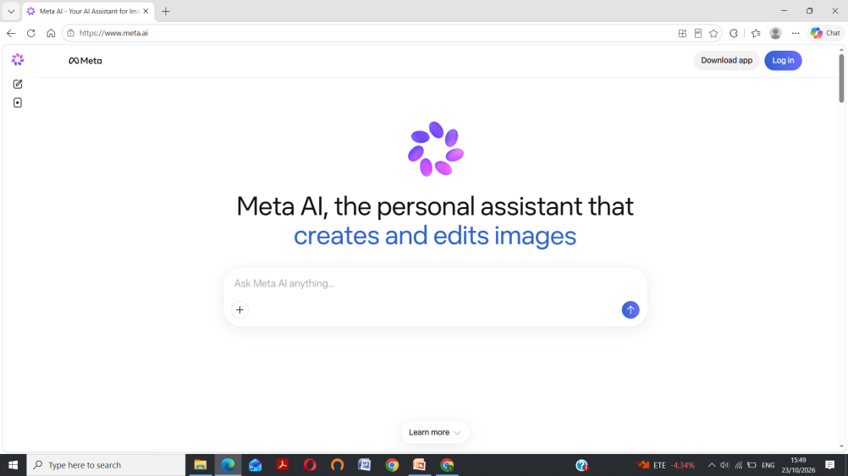
Computational Advertising Message - AI
AI presents new directions and opportunities in computational advertising message creation and placement.
Generative AI (genAI) tools make possible fully AI-generated visuals, copy, and video ads (so-called synthetic advertising).
Synthetic advertising is actively embraced by big tech platforms.
Example:
Meta’s genAI tool for Facebook and Instagram will permit brands to upload product images and budget, and then it will automatically generate complete ads, including customized images, videos, text, and audience targeting
Meta AI - Your AI Assistant for Images, Shopping and More

Slide 9
Computational Advertising Message - AI
AI enables
AI-influencers, synthetic personas that simulate human-like behaviors and appearance to engage audiences, promote brands, and influence consumer decisions on social media platforms.
hyper-personalization of synthetic advertising content that is created to match the individual consumer’s exact interest and intention inferred from their past online behaviors.
AI has revolutionized media planning, it is used to analyze large volumes of consumer, market, and performance data to optimize computational advertising campaigns .

Slide 10


AI-influencers
https://www.kolsquare.com/en/top-influencers/10-ai-influencers-transforming-social-media
https://www.amraandelma.com/top-ai-generated-influencers/

Slide 11
Automated Brand-Generated Content (ABC) Model
Core Components of the ABC Model proposed by Van Noort et al., (2020).
Consumer Data Inputs: Demographics, online behaviors, psychographics, attitudinal/perceptual privacy concerns, and transparency expectations.
Brand Data Inputs: Brand identity coherence, value centrality, brand trust, and brand relationship quality.
Short-Term Impacts: Immediate consumer behavioral responses such as clicks, views, and direct engagement.
Long-Term Impacts: Sustainable brand equity, long-term trust, and cumulative consumer receptivity.
Van Noort, G., Himelboim, I., Martin, J., & Collinger, T. (2020). Introducing a model of automated brand-generated content in an era of computational advertising. Journal of Advertising, 49(4), 411-427.

Slide 12
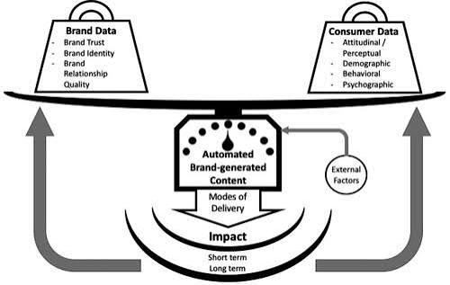
Automated Brand-Generated Content (ABC) Model

Slide 13
Automated Brand-Generated Content Model
Beyond synthetic content, consumers can also play an active role in the creation of computational advertising messages.
The conceptual framework for user-brand relationships in advertising.
The framework identifies three distinct consumer roles in computational advertising, each defined by the type of engagement and data the engagement generates.
  Content creators contribute original or derivative brand-related material (e.g., reviews), providing rich, expressive data.
  Metavoicers interact with existing content by (like, comment, rate) liking, commenting, or rating, offering evaluative signals.
  Propagators share content across their networks, generating data uniquely tied to social connections and diffusion dynamics.
Together, these roles demonstrate how consumers form and strengthen computational advertising content, while producing diverse and rich data.

Slide 14
Creation of Computational Advertising Messages
The creation of computational advertising messages involves
the automated generation of ads based on data inputs, user profiling, and algorithmic decision-making
Historically, brand-generated content was the product of a creative process led by advertising professionals working on behalf of brands.
Due to recent progresses in AI, brand-generated content today is gradually more computer-generated based on consumer data, with minimal or no human contribution.
Such advertising relies on various AI techniques, such as generative adversarial networks, to automatically create content that depicts an unreal, but persuasive, artificial version of reality.

Slide 15
Automated Brand-Generated Content Model
Key points in ABC model
Content must be evaluated not only in terms of its effectiveness and scalability but also in terms of authenticity, brand fit, and consumer trust.
As algorithmic systems are increasingly able to independently create persuasive messages, the boundaries between human and machine authorship blur, raising new questions about
  creative control,
  brand consistency, and
  ethics of AI generation of content.

Slide 16
Bibliography
Rodgers, S., & Thorson, E. (Eds.). (2026). Digital Advertising Theory. Taylor & Francis.
Van Noort, G., Himelboim, I., Martin, J., & Collinger, T. (2020). Introducing a model of automated brand-generated content in an era of computational advertising. Journal of Advertising, 49(4), 411-427.

