Slide 2


Advertising & Communication Management case study
Polyxeni (Jenny) Palla, PhD

Slide 3


Case Study: SSE
SSE supplies electricity and gas to millions of households and businesses across the UK and Ireland and is one of the ‘big six’ in the UK.
Location
UK and Ireland

Slide 4


The challenge
Inviqa (formerly Webcredible) began working with SSE’s digital team to develop its experience design capabilities and support their digital transformation programme to:
increase conversion across key user journeys;
transform in-house digital capabilities;
embed user-centred design in the organization.

Slide 5
Agreed objectives for Inqiva were to:
Change the way SSE delivers digital products, moving away from small tactical design projects to well-executed design sprints in collaboration with the business and technical teams.
Provide design leadership to the team, helping streamline and improve the design output and providing additional design resource.
In line with SSE’s business objectives, Inviqa focused their work on
  the retention of existing customers.
  the acquisition of new customers.
  the channel shift towards digital touchpoints.
Conduct ongoing research to validate collaborative design work, ensuring SSE could grow the business digitally and cater for new and existing customer needs.
Act as a strategic partner, helping manage the digital roadmap while guiding and upskilling SSE teams to follow best practice user experience and drive efficiencies.

Slide 6

Target Audience
Consumers of home electricity and gas services in the UK.

Slide 7
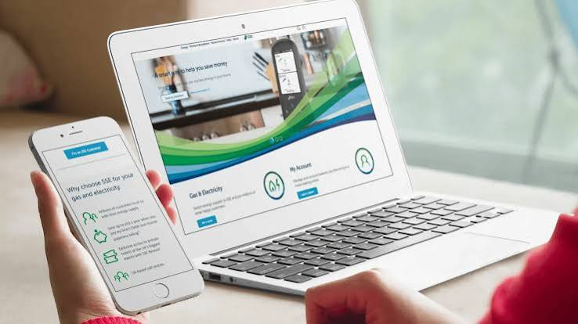
Action
Inviqa worked with SSE’s digital team on-site every week. This helped Inviqa understand how the company worked and take a more active role in its digital activities.
During their three-year partnership, Inviqa worked on several important activities,

Slide 8
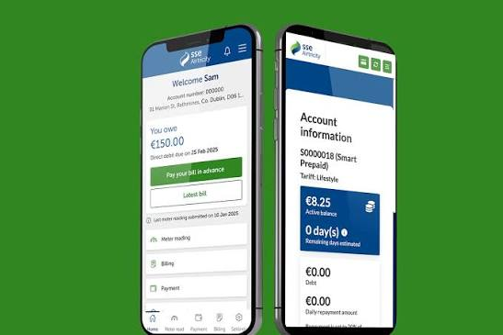
Action: What Inviqa Did
Set business goals: Held workshops with senior managers to agree on business goals and how to measure success (KPIs).
Checked digital skills: Evaluated SSE’s digital skills and identified areas for improvement.
Improved the website: Researched how customers used the main website and online account area, and suggested improvements.
https://www.sse.com/
Organised design workshops: Worked with designers and managers to develop ideas, create prototypes, and test them with users.
Improved testing: Helped SSE plan A/B and multivariate tests to compare different versions of its website.

Slide 9
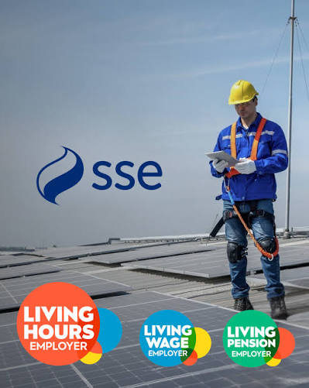
Action: What Inviqa Did
Created customer personas: Developed profiles of typical customers based on user research, helping the company better understand their needs.
Trained the design team: Supported team members in learning more about user experience (UX).
Created design guidelines: Built a shared library of design elements to make SSE’s digital products more consistent and help the team work faster.
Key outcome: Inviqa helped SSE change its working culture by encouraging teamwork, customer-focused thinking, and the use of research to make better decisions.

Slide 10

Action: What Inviqa Did
Inviqa helped SSE change the way it worked by making customer needs a priority, improving the design process, and helping the company work more efficiently.
This led to the development of new digital services designed around customers’ needs, including:
An accessible sign-up service: A service that all customers could use to register easily.
A new customer app: An app designed to make it easier for customers to use SSE’s services.

Slide 11
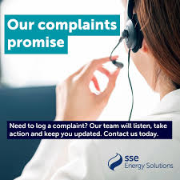
Designing an accessible service for all
Inclusive Design and Accessibility
SSE wanted to make its digital services easier to use for all customers, including older people and those with accessibility needs.
Improving sign-up: Inviqa and SSE focused on the online sign-up process because it was one of the most important parts of the website.
Reviewing the design: They checked the website’s design rules and style guide to make sure accessibility was considered in every design decision.
Changing brand colours: They adjusted some of SSE’s main colours and their use to improve contrast and make the website easier to read.

Slide 12

Designing an accessible service for all
Changing brand colours: They adjusted some of SSE’s main colours and their use to improve contrast and make the website easier to read.
Testing accessibility: After making improvements, SSE tested its digital services with real customers to identify further problems.
Building awareness: SSE encouraged employees to understand the importance of accessibility and include it when developing new digital products.
Key outcome: Accessibility became an important part of SSE’s design process, helping the company create more inclusive digital services for all customers.

Slide 13
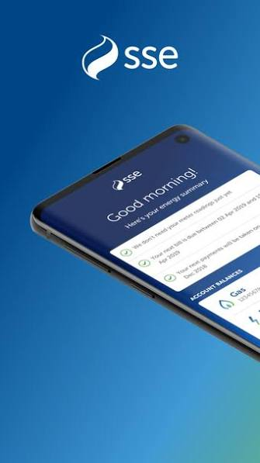
A new user-centred app for customers
Developing a Customer-Friendly App
SSE wanted to create an app that would help customers submit meter readings, check their bills, and understand their energy use more easily.
Inviqa helped SSE design and test the app through the following activities:
Feature planning: Held a workshop to decide which features were most important.
Design sprints: Completed five design sprints, including research into other energy apps and apps from different industries.
Customer research: Conducted three rounds of research to understand users’ needs and gather feedback.

Slide 14
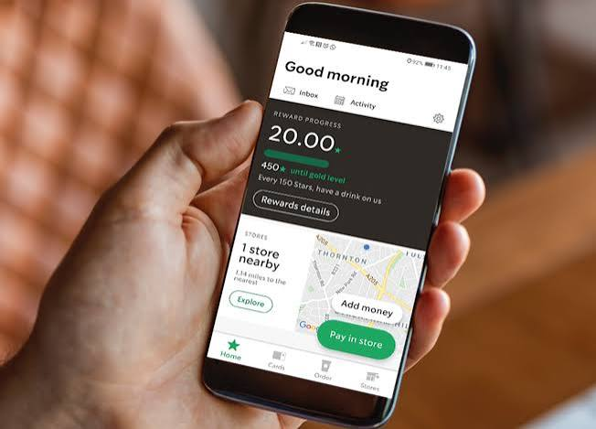
A new user-centred app for customers
Accessibility audit: Checked how easy the app was to use for people with different needs.
Key outcome: SSE developed an app that allows customers to access important information and submit meter readings easily.
Example of innovation: The app includes an automatic meter-reading feature. Customers point their phone camera at the meter, and the app uses the phone’s light to take a clear picture and read the numbers automatically, without requiring customers to enter them manually.

Slide 15
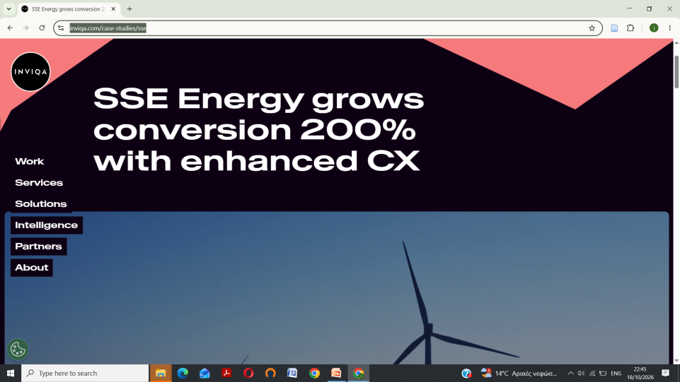
The results
Results and Achievements
The collaboration between Inviqa and SSE led to improvements in digital performance, customer experience, and the company’s internal skills.
https://inviqa.com/
https://inviqa.com/case-studies/sse
1. Better digital performance
Improved the digital skills of SSE’s employees.
Introduced customer-focused design and created an internal lab for user testing.
Increased conversions by 200% for the telecommunications sign-up process.
Increased conversions by 60% for the energy sign-up process.
2. Improved accessibility
Conducted research with users who had accessibility needs.
Trained development, design, testing, and content teams to make digital services more accessible.

Slide 16
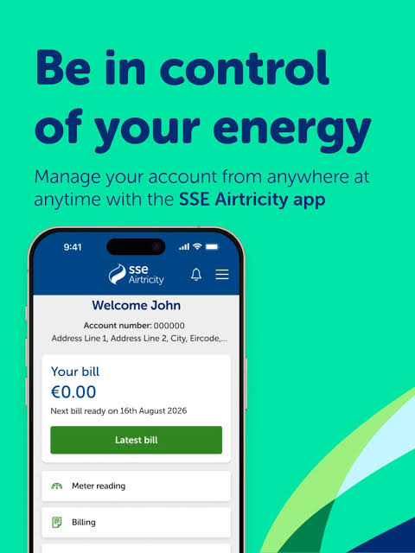
The results
3. Successful launch of SSE’s first app
During its first six months, the app achieved the following results:
136,500 downloads across Android and iOS.
874,198 dashboard views.
88,450 bill downloads.
26,353 meter readings submitted.
App ratings: 4.8 stars on Android and 4.7 stars on iOS.
4. A change in working culture
Over three years, Inviqa helped SSE move away from teams working separately on small projects towards a more collaborative approach focused on customer needs.
The digital team also gained greater recognition within the company, demonstrating the value of good user experience design.
Key Takeaway
The SSE case shows how user research, teamwork, accessibility, and user-centred design can improve digital services, increase conversions, and create a better customer experience.

Slide 17
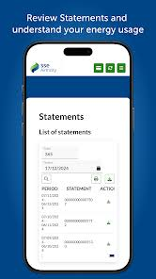
Comment
“With Inviqa’s support, SSE improved its main sign-up processes and created a better experience for customers. The project also showed how understanding customer needs and improving user experience can benefit the business.”
— Chris Golding, Digital UX Manager, SSE

