Slide 1
Διοίκηση Τεχνολογίας
Εργασία: “Sources of Innovation”
Πρόγραμμα:MBA Part-Time

Slide 2
Χρηματοδότηση
Το παρόν εκπαιδευτικό υλικό έχει αναπτυχθεί στα πλαίσια του εκπαιδευτικού έργου του διδάσκοντα.
Το έργο «Ανοικτά Ακαδημαϊκά Μαθήματα στο Οικονομικό Πανεπιστήμιο Αθηνών» έχει χρηματοδοτήσει μόνο τη αναδιαμόρφωση του εκπαιδευτικού υλικού.
Το έργο υλοποιείται στο πλαίσιο του Επιχειρησιακού Προγράμματος «Εκπαίδευση και Δια Βίου Μάθηση» και συγχρηματοδοτείται από την Ευρωπαϊκή Ένωση (Ευρωπαϊκό Κοινωνικό Ταμείο) και από εθνικούς πόρους.

Slide 3
Άδειες Χρήσης
Το παρόν εκπαιδευτικό υλικό υπόκειται σε άδειες χρήσης Creative Commons.

Slide 4
Introduction
Innovation: the practical implementation of an idea into a new product or process.
5 Distinct sources of innovation:
Individuals
Firms
Universities
Government Funded Research
Private non profit Organizations

Slide 5
Idea - Creativity
Idea: Something imagined in the mind - In a popular sense, an idea arises in a reflexive, spontaneous manner.
Creativity: The Ability to produce useful ideas and work. – Novel →Καινοφανές
Individual creativity
Organizational Creativity

Slide 6
Creativity Into Action - Individuals
Inventors
Trained in multiple fields – Highly curious – Question assumptions – View unified Knowledge / Sometimes Inventive & Entrepreneurial traits
Self Users
Create Solutions to their own needs
Create innovations for their own use and not for profit as manufacturers typically do

Slide 7
Firms
Research and Development Business Unit
It’s considered to be one of the most important drivers of innovation within the system context.
Collaboration with:
Customers
Suppliers
Universities
Government institutions

Slide 8
Universities
Scientific faculties engage in research projects that may lead to useful innovations for the society.
Technology Transfer Offices
Facilitation of the technology developed inside universities to organizations where it can be commercially applied
Publication of research Findings

Slide 9
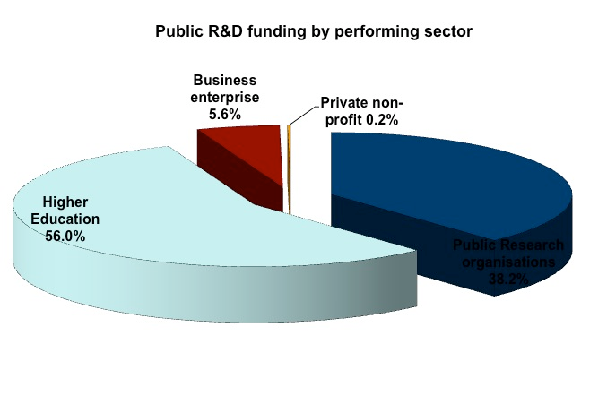
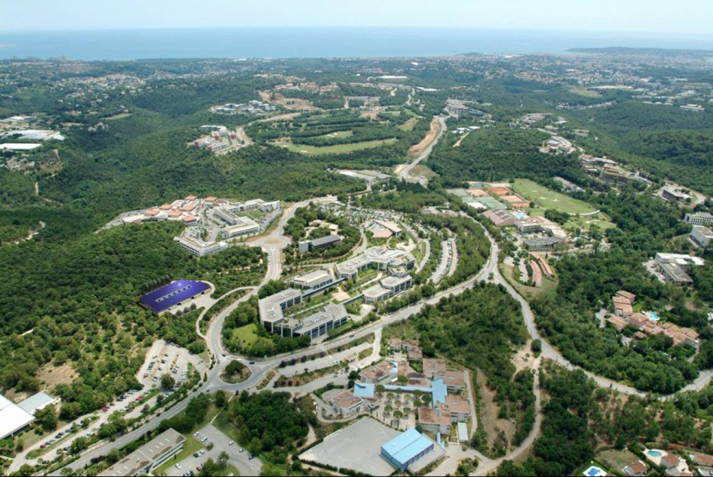
Government Funded Research
Governments care about public prosperity, they invest in research through:
Own laboratories
Science parks & Incubators
Fund other public or private research entities
EU: Platform on Research and Innovation policies and systems Greece
Sophia Antipolis technology park, France

Slide 10
Private Non-Profit Organizations
Private non profit organizations perform in-house R&D or Fund the efforts of other entities.
Such Non-profits are:
Research institutes
Nonprofit hospitals
Private Foundations
Trade Associations etc.

Slide 11
Collaborative Networks
Collaborative networks are joint ventures of research entities, where they unite resources and capabilities in order to develop and implement significant innovation.
Technology Clysters (Geo Proximity)
Increase the productivity of the companies in the cluster:
by driving innovation in the field,
by stimulating new businesses in the field

Slide 12
Τέλος Εργασίας “Sources of Innovation”
Μάθημα: Διοίκηση Τεχνολογίας
Πρόγραμμα: MBA Part-Time

